Slide 1
Object－Oriented Programming
Polymorphism
Weiwei Xu

Slide 2
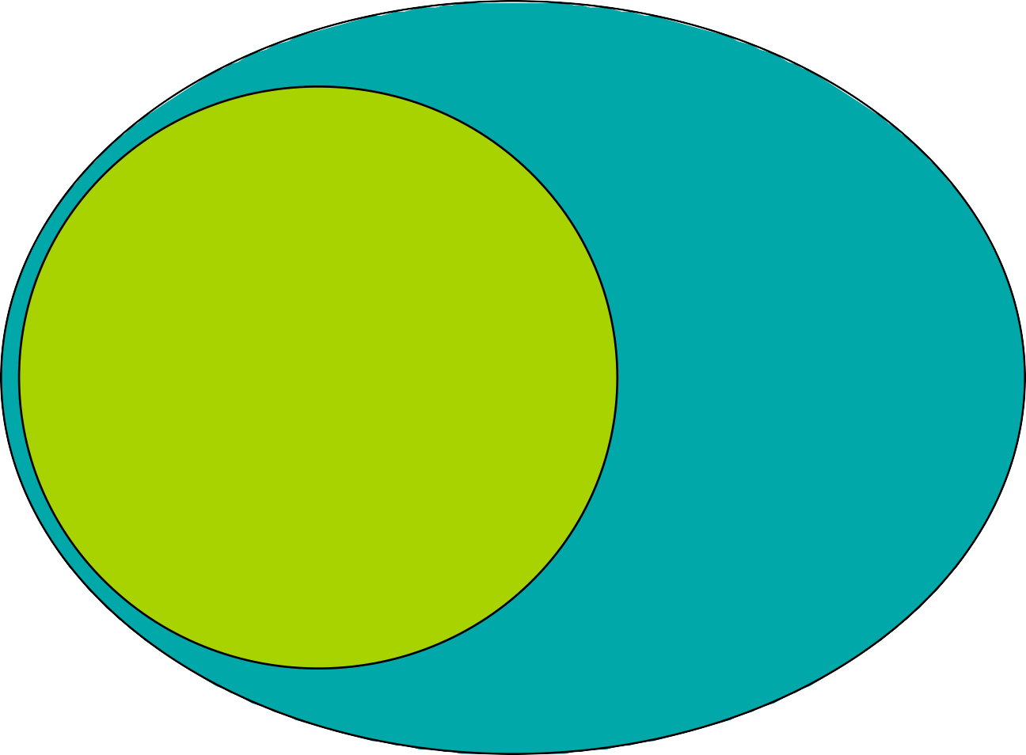
Inheritance
The ability to define the behavior or
implementation of one class as a superset of another class
Person
Student
2

Slide 3
Inheritance
Class relationship: Is-A
Employee
Base Class Super Parent
Derived Class Sub
Child
Manager
3

Slide 4
Conversions
Public Inheritance should imply substitution
–If B isa A, you can use a B anywhere an A can be used.
if B isa A, then everything that is true for A is also true of B
–Be careful if the substitution is not valid!
4

Slide 5
Upcasting
Upcasting is the act of converting from a Derived reference or pointer to a base class reference or pointer.
Base
Derived
5

Slide 6
Upcasting examples
Manager pete( "Pete", "444-55-6666", "Bakery"); Employee* ep = &pete; // Upcast
Employee& er = pete; // Upcast
Lose type information about the object:
ep->print( cout ); // prints base class version
6

Slide 7
A drawing program
Rectangle
Circle
Ellipse
Operations
render
move
resize
Data
+ center
7

Slide 8
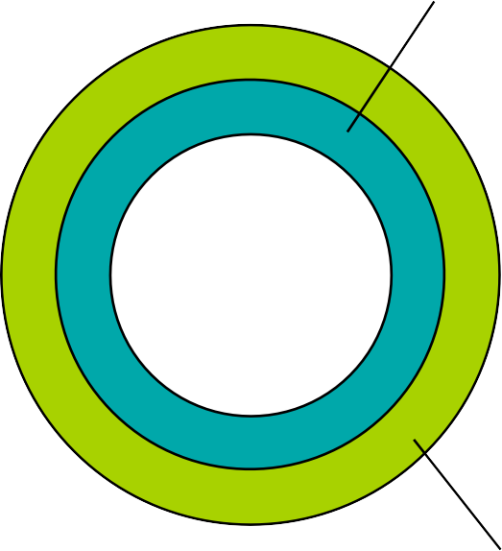
Inheritance in C++
Can define one class in terms of another
Can capture the notion that
–An ellipse is a shape
–A circle is a special kind of ellipse
–A rectangle is a different shape
Ellipse
Shape
–Circles, ellipses, and rectangles share common
attributes
services
–Circles, ellipses, and rectangles are not identical
Circle
8

Slide 9

Conceptual model
center move() render()
Shape
Rectangle
render()
Ellipse
render()
Square
render()
Circle
render()
Note: Deriving Circle from Ellipse is a poor design choice!

Slide 10
Shape
Define the general properties of a Shape
class XYPos {...}; // x.y point
class Shape {
public:
Shape();
virtual ~Shape();
virtual void render();
void move(const XYPos&);
virtual void resize();
protected:
XYPos center;
}

Slide 11
Add new shapes
class Ellipse: public Shape{
public:
Ellipse(float maj, foat minr);
virtual void render(); // will define own
protected:
float major_axis, minor_axis;
};
class Circle: public Ellipse{
public:
Circle(float radius) : Ellipse(radius, radius) {}
virtual void render();
};

Slide 12
Example
void render(Shape* p){
p->render(); // calls correct render function
} // for given Shape!
void func(){
Ellipse ell(10, 20);
ell.render();
Circle circ(40);
circ.render();
render(&ell);
render(&circ);
}

Slide 13
Polymorphism

Slide 14
Polymorphism
Upcast: take an object of the derived class as an object of the base one.
–Ellipse can be treated as a Shape

Slide 15
Polymorphism
Upcast: take an object of the derived class as an object of the base one.
–Ellipse can be treated as a Shape
Dynamic binding:
–Binding: which function to be called
Static binding: call the function as the code
Dynamic binding: call the function of the object

Slide 16
How virtuals work in C++
class Shape { public:
Shape();
virtual ~Shape();
virtual void render();
A Shape
vtable
center
Shape vtable
void move(const
XYPos&);
virtual void resize(); protected:
XYPos center;
};
Shape::dtor()
Shape::render()
Shape::resize()
see: virtual.cpp

Slide 17
Ellipse
class Ellipse: public Shape{
public:
Ellipse(float maj, foat minr);
virtual void render();
protected:
float major_axis,;
float minor_axis;
};
An Ellipse
vtable
center
major_axis
minor_axis
Ellipse vtable
Ellipse::dtor()
Ellipse::render()
Shape::resize()

Slide 18
Shape vs Ellipse
A Shape
An Ellipse
vtable
vtable
center
major_axis
minor_axis
center
Shape vtable
Ellipse vtable
Shape::dtor()
Shape::render()
Shape::resize()
Ellipse::dtor()
Ellipse::render()
Shape::resize()

Slide 19
Circle
class Circle: public Ellipse{
public:
Circle(float radius);
virtual void render();
virtual void resize();
virtual float radius();
protected:
float area;
};
A Circle
vtable
center
major_axis
minor_axis
area
Circle vtable
Circle::dtor()
Circle::render()
Circle::resize()
Circle::radius()

Slide 20
What happens if

Slide 21
What happens if
Ellipse Circle
elly(20F, 40F);
circ(60F);
elly = circ; // 10 in 5?

Slide 22
What happens if
Ellipse Circle
elly(20F, 40F);
circ(60F);
elly = circ; // 10 in 5?
Area of circ is sliced off
– (Only the part of circ that fits in elly gets copied)

Slide 23
What happens if
Ellipse Circle
elly(20F, 40F);
circ(60F);
elly = circ; // 10 in 5?
Area of circ is sliced off
– (Only the part of circ that fits in elly gets copied)
Vtable from circ is ignored; the vtable in elly is the Ellipse vtable
elly.render(); // Ellipse::render()

Slide 24
What happens with pointers?

Slide 25
What happens with pointers?
Ellipse* | elly | = | new | Ellipse(20F, | 40F);
Circle* | circ | = | new | Circle(60F);
elly
= circ;

Slide 26
What happens with pointers?
Ellipse* | elly | = | new | Ellipse(20F, | 40F);
Circle* | circ | = | new | Circle(60F);
elly
= circ;
Well, the original Ellipse for elly is lost....

Slide 27
What happens with pointers?
Ellipse* | elly | = | new | Ellipse(20F, | 40F);
Circle* | circ | = | new | Circle(60F);
elly
= circ;
Well, the original Ellipse for elly is lost....
elly and circ point to the same Circle object!
elly->render();
// Circle::render()

Slide 28
Virtuals and reference arguments

Slide 29
Virtuals and reference arguments
void func(Ellipse& elly) { elly.render();
}
Circle circ(60F); func(circ);

Slide 30
Virtuals and reference arguments
void func(Ellipse& elly) { elly.render();
}
Circle circ(60F); func(circ);
References act like pointers

Slide 31
Virtuals and reference arguments
void func(Ellipse& elly) { elly.render();
}
Circle circ(60F); func(circ);
References act like pointers
Circle::render() is called

Slide 32
Virtual destructors
Make destructors virtual if they might be inherited
Shape
...
delete p;
*p = new Ellipse(100.0F, 200.0F);
Want Ellipse::~Ellipse() to be called
– Must declare Shape::~Shape()
virtual
– It will call Shape::~Shape()
automatically
If Shape::~Shape() is not virtual, only
Shape::~Shape() will be invoked!

Slide 33
Overriding
Overriding redefines the body of a virtual function
class Base {
public:
virtual
}
void
func();
class Derived
: public
Base {
public:
virtual
void func();
//overrides
Base::func()
}

Slide 34
Calls up the chain
You can still call the overridden function:
void Derived::func() {
cout << "In
Derived::func!";
Base::func(); // call to base class
}
This is a common way to add new functionality
No need to copy the old stuff!

Slide 35
Return types relaxation (current)
Suppose D is publicly derived from B
• D::f() can return a subclass of the return type defined in B::f()
Applies to pointer and reference types
– e.g.
D&, D*
In most compilers now

Slide 36
Relaxation example
class Expr{
public:
virtual Expr* newExpr();
virtual Expr& clone();
virtual Expr self();
};
class BinaryExpr: public Expr{
public:
virtual BinaryExpr* newExpr(); // ok
virtual BinaryExpr& clone(); // ok
virtual BinaryExpr self(); // Error!
};

Slide 37
Overloading and virtuals
Overloading adds multiple signatures
class Base { public:
};
If you override an overloaded function, you must override all of the variants!
–Can't override just one
–If you don't override all, some will be hidden
virtual | void | func();
virtual | void | func(int);

Slide 38
Overloading example
When you override an overloaded function, override all of the variants!
class Derived: public Base{
public:
virtual void func(){
Base::func();
}
virtual void func(int) { ... };
}

Slide 39
Tips
Never redefine an inherited non-virtual function
–Non-virtuals are statically bound
–No dynamic dispatch!
Never redefine an inherited default parameter value
–They’re statically bound too!
–And what would it mean?

Slide 40
Virtual in Ctor?
class A {
public:
A() { f(); }
virtual void f() { cout << "A::f()"; }
};
class B : public A {
public:
B() { f(); }
void f() { cout << "B::f()"; }
};

Slide 41
Multiple Inheritance
Employee
Temporary
Secretary
MTS
Administrator
TempSec
Supervisor
President
Consultant

Slide 42
Mix and match
class Employee {
protected:
String name;
EmpID id;
};
class MTS : public Employee {
protected:
Degrees degree_info;
};
class Temporary {
protected:
Company employer;
};
class Consultant:
MTS,
Temporary {
...
};
Consultant picks up the attributes of both MTS and Temporary.
name
id
employer
degree_info
public public

Slide 43
MI Complicates Data Layouts
Employee
MTS
Employee
Temporary
Consultant

Slide 44

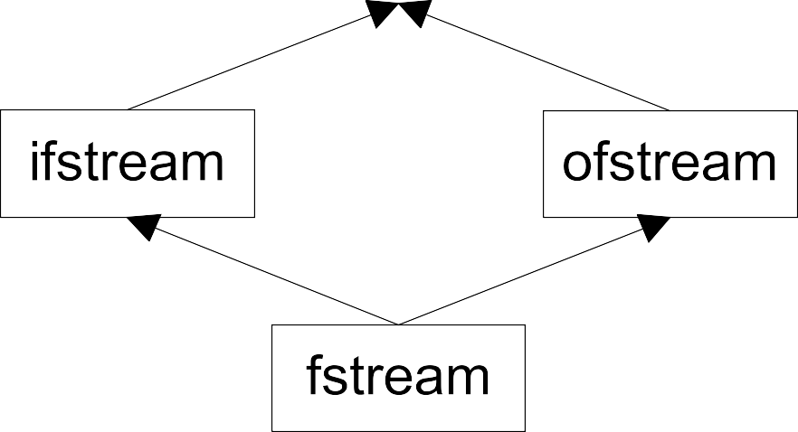
IOStreams package

Slide 45
Vanilla MI
Members are duplicated
Derived class has access to full copies of each base class
This can be useful!
–Multiple links for lists
–Multiple streambufs for input and output
IOS
streambuf
ostream
istream
streambuf
streambuf
iostream
streambuf
streambuf

Slide 46
More on MI...
class B1 { int m_i; };
class D1 : public B1 {};
class D2 : public B1 {};
class M : public D1, public D2 {};
void main() {
M m; // OK
B1* p = new M; // ERROR: which B1
B1* p2 = dynamic_cast<D1*>(new M); // OK
}
B1 is a replicated sub-object of M.

Slide 47
Replicated bases
Normally replicated bases aren’t a problem (usage of B1 by D1 and D2 is an implementation detail).
Replication becomes a problem if replicated data makes for confusing logic:
M m;
m.m_i++; // D2::B1.m_i?
ERROR:
D1::B1.m_i or

Slide 48
Safe uses
Protocol classes

Slide 49
Protocol/Interface classes
Abstract base class with
–All non-static member functions are pure virtual except destructor
–Virtual destructor with empty body
–No non-static member variables, inherited or otherwise
May contain static members

Slide 50
Example interface
Unix character device
class CDevice {
public:
virtual ~CDevice();
virtual int read(...) = 0;
virtual int write(...) = 0;
virtual int open(...) = 0;
virtual int close(...) = 0;
virtual int ioctl(...) = 0;
};

Slide 51
Safe uses
Protocol classes

Slide 52
What about sharing?

Slide 53
What about sharing?
How do you avoid having two streambufs?

Slide 54
What about sharing?
How do you avoid having two streambufs?
Base classes can be virtual
–To C++ people, “virtual” means “indirect”

Slide 55
What about sharing?
How do you avoid having two streambufs?
Base classes can be virtual
–To C++ people, “virtual” means “indirect”
Virtual member functions have dynamic binding
–They use pointer indirection

Slide 56
What about sharing?
How do you avoid having two streambufs?
Base classes can be virtual
–To C++ people, “virtual” means “indirect”
Virtual member functions have dynamic binding
–They use pointer indirection
Virtual base classes are represented indirectly
–They use pointer indirection

Slide 57
Using virtual base classes
Virtual base classes are
shared
Derived classes have a single copy of the virtual base
Full control over sharing
–Up to you to choose
Cost is in complications
IOS
streambuf
istream
ostream
streambuf
streambuf
iostream
streambuf
has-a isa

Slide 58
Virtual bases
class B1 { int m_i; };
class D1 : virtual public B1 {};
class D2 : virtual public B1 {};
class M : public D1, public D2 {};
void main() {
M m; // OK
m.m_i++; // OK, there is only one B1 in m.
B1* p = new M; // OK
}

Slide 59
Complications of MI
Name conflicts
–Dominance rule
Order of construction
–Who constructs virtual base?
Virtual bases not declared when you need them
A
Code in virtual bases called more than once
Compilers are still iffy
Moral:
– Use sparingly
– Avoid diamond patterns
expensive
hard
B
C
D

Slide 60
Virtual bases
Use of virtual base imposes some runtime and space overhead.
If replication isn’t a problem then you don’t need to make bases virtual.
Abstract base classes (that hold no data except for a vptr) can be replicated with no problem - virtual base can be eliminated.

Slide 61
TIPS for MI

Slide 62
TIPS for MI
SAY

Slide 63
TIPS for MI
SAY
NO

